Slide 1


Azure Monitoring Hackathon Overview
Azure Monitor, Log Analytics & Application Insights
June 2018
v101617

Slide 2
Why this is so hard
Frustrations with getting exceptions/logs/data
Issues caused by config, data, and scale
Acquiring and configuring the tools

Slide 3
Manage Experience
User expectations are high
Brave new world!
Software will have bugs
Hardware will fail
Humans will make mistakes
Running a cloud service at scale is challenging!
Expectations
Easy way to monitor heterogeneous apps
Get notified if something is not right
Self-help & troubleshooting tools
Assisted support when needed
Low tolerance for unavailable / unhealthy services or downtimes
Notes:
Key points to land:
Cloud changes how you run your service – you no longer have direct access to infrastructure so troubleshooting & debugging requires different tools
Tolerance for unavailable or unhealthy services is non-existent. We expect service uptime the same way we expect electricity to always be available
When something isn’t right, or unhealthy, detection & mitigations must be quick and automated.
To reach this goal, you must have quick detection, ability to run automated mitigations, automated notifications to the right people in a timely manner…
…self help diagnostics, and a cloud provider to assist you when you need help

Slide 4


Slide 5

Introducing Azure Monitor
Built-in monitoring capabilities for Azure resources
Out of the box metrics and logs
Alert rules to get notified & take automated actions
Single dashboard view for Platform and Application monitoring
APIs for 3rd party integration
Notes:
Key Points:
We are announcing a new service called Azure Monitor
Azure Monitor has built-in monitoring on many Azure resources with metrics out-of-the-box without needing to enable any diagnostics.
Azure Monitor brings together in a single experience the ability to see:
What’s changed in your resources (Activity Log),
Discover & Explore Metrics and immediately chart them for many Azure Resources, including Host Metrics
Configure your diagnostic logs to archive into your storage account, stream to event hubs for others to consume, and/or stream directly to Operation Management Suite
Set up Alerts, Notifications and Automated Actions.
4) Ability to create dashboards with platform, application & custom metrics.
5) REST API, event hubs for 3rd party integration

Slide 6
E2E Monitoring Experience on Azure
Azure Portal
3rd party products, integrate via REST API, Event Hub, Storage log files
Azure Monitor
(platform monitoring)
Application Insights (Application monitoring)
Log Analytics, Automation, Solutions (OMS)
On-prem, hybrid/ external cloud data
Azure services

Slide 7
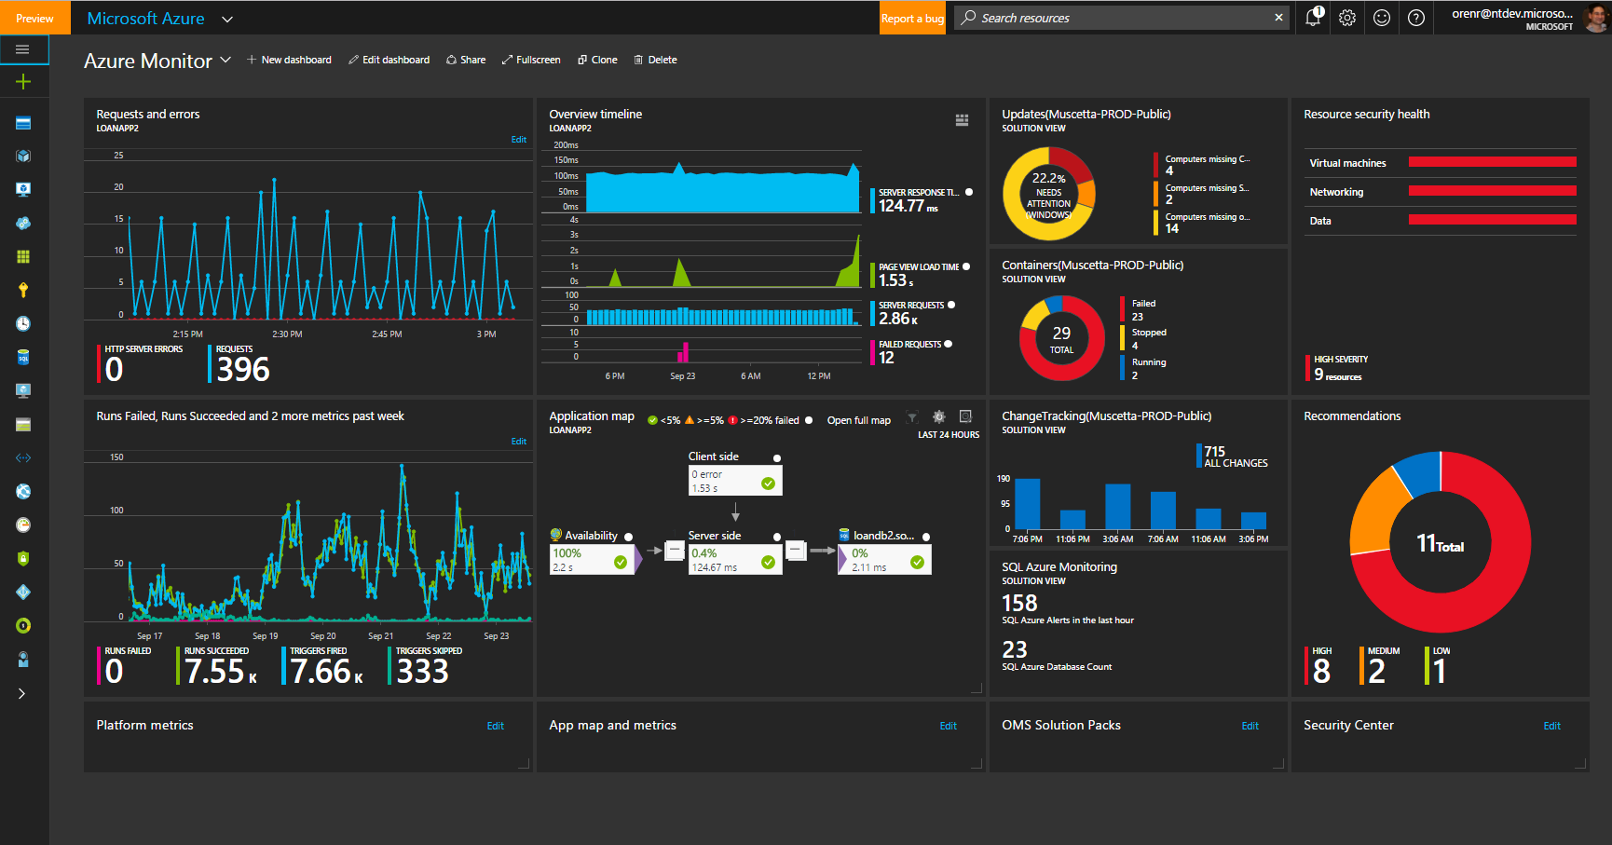
Azure Monitor - Dashboard
Platform Monitoring
Application Monitoring
OMS Solutions
Security Center
Notes:
Here’s an example dashboard. In one pane of glass I have platform monitoring, application monitoring, solutions from OMS providing me deeper insights into my data, and in this example I have Security center recommendations pinned.

Slide 8
One dashboard
Monitoring everything in one place
Data from Azure Monitor,
App Insights & OMS Log Analytics
Share or clone dashboards

Slide 9
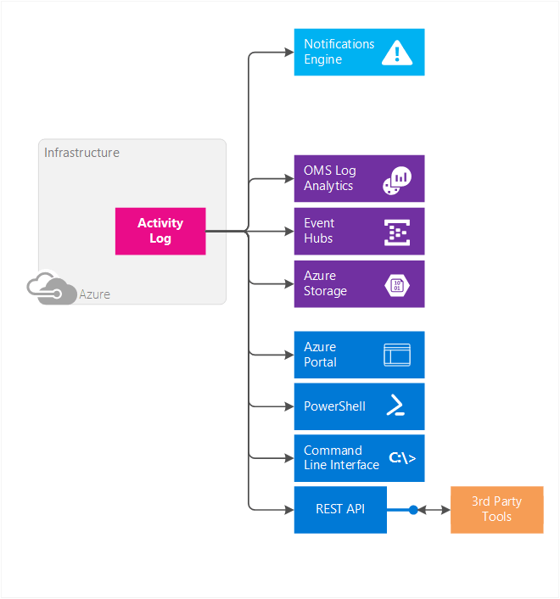
Activity Log
Notes:
Most Azure resources emit metrics. These metrics accessible via portal, PowerShell, CLI, REST API (for 3rd party integration) and they can also be routed to OMS, Event Hub and Azure storage. The same metrics power Alerts and autoscale (for Websites and VMSS)

Slide 10
Contains log of management operations on resources
Consume via portal or REST API
90-day data retention
Export to Blob storage or stream to Event Hub
In-built search & analytics via OMS Log Analytics
Activity log

Slide 11
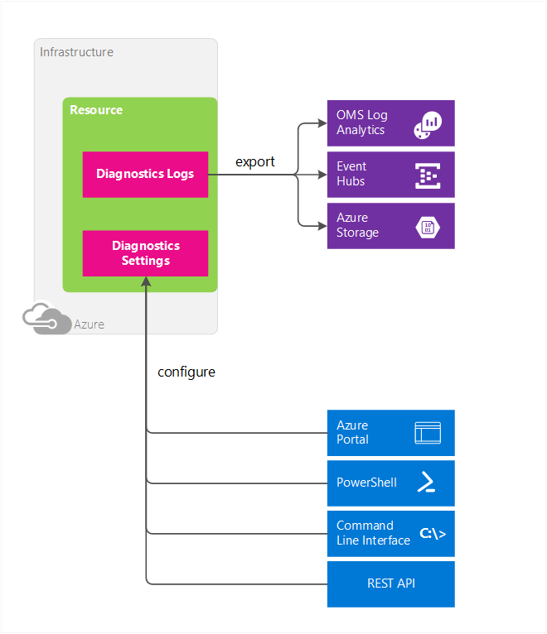
Diagnostic Logs Configure & Export options
Notes:
Most Azure resources emit metrics. These metrics accessible via portal, PowerShell, CLI, REST API (for 3rd party integration) and they can also be routed to OMS, Event Hub and Azure storage. The same metrics power Alerts and autoscale (for Websites and VMSS)

Slide 12
Manage diagnostics settings in one place
Diagnostic logs
Blob storage for archival or offline reporting
Stream to Event Hub for custom app or 3rd party integration
Route to OMS Log Analytics for advanced analytics

Slide 13
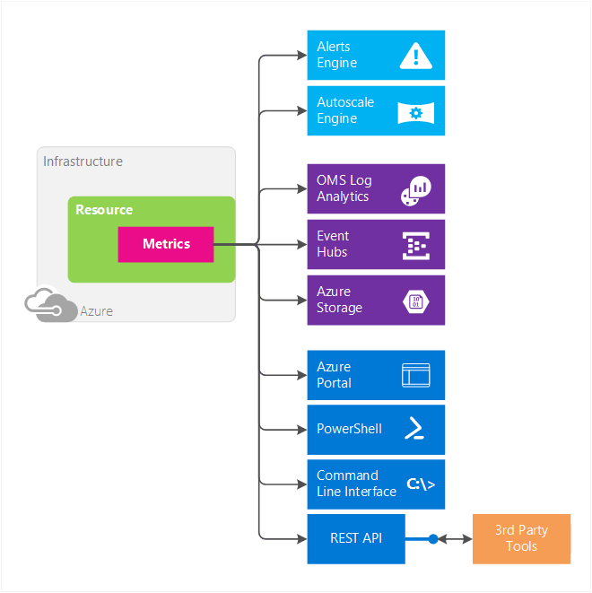
Metrics
Notes:
Most Azure resources emit metrics. These metrics accessible via portal, PowerShell, CLI, REST API (for 3rd party integration) and they can also be routed to OMS, Event Hub and Azure storage. The same metrics power Alerts and autoscale (for Websites and VMSS)

Slide 14
More Azure resources now provide metrics
1-minute granularity
30-day data retention
No diagnostics setup (or storage account) required
Consume via Portal or REST API
Opt-in to detailed monitoring on VMs
Metrics

Slide 15
Turn on Application Insights for app monitoring
Custom metrics & app analytics
Unlock deep app telemetry on web sites & VMs
Alert on custom metrics and events via TrackMetric and TrackEvent API
Built-in analytics for advanced app monitoring

Slide 16
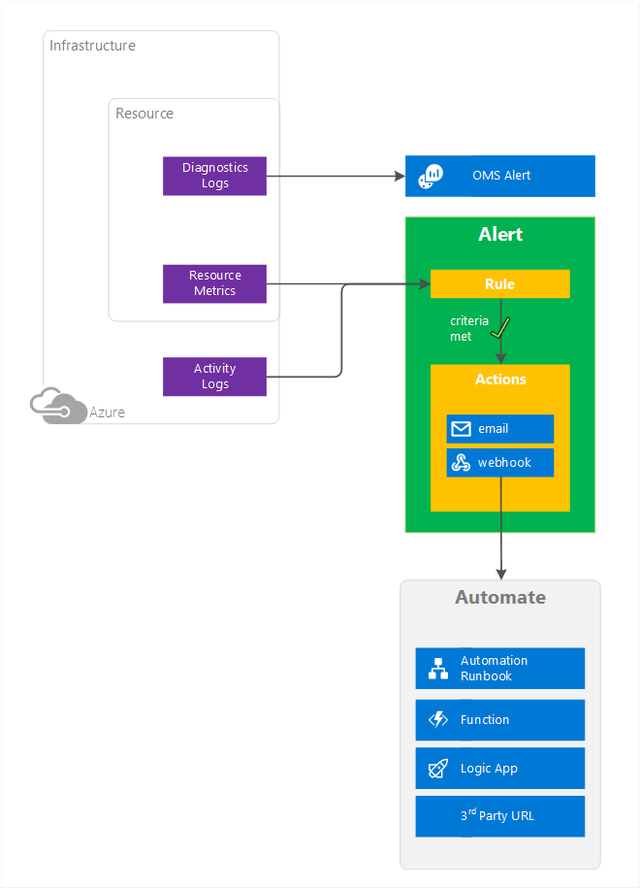
Alerts
Notes:
Most Azure resources emit metrics. These metrics accessible via portal, PowerShell, CLI, REST API (for 3rd party integration) and they can also be routed to OMS, Event Hub and Azure storage. The same metrics power Alerts and autoscale (for Websites and VMSS)

Slide 17
Manage all alerts in one place
Alert rules
Alert on platform, app and custom metrics with email and webhook notifications
Alerts on Activity log & Service Health notifications
Manage alerts better using reusable Action Groups

Slide 18
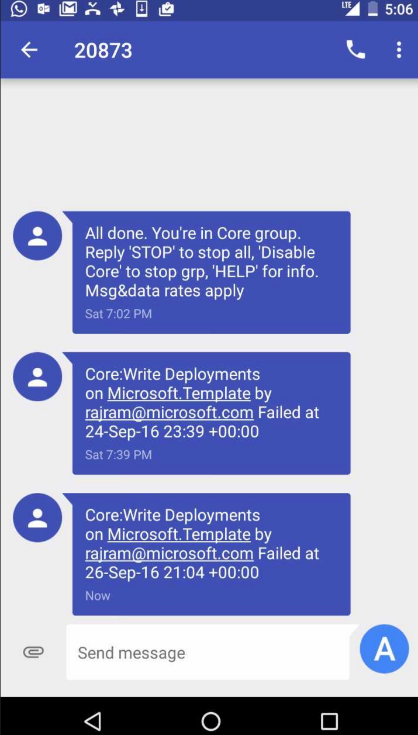
SMS for Activity Log & Service Health Notifications

Slide 19
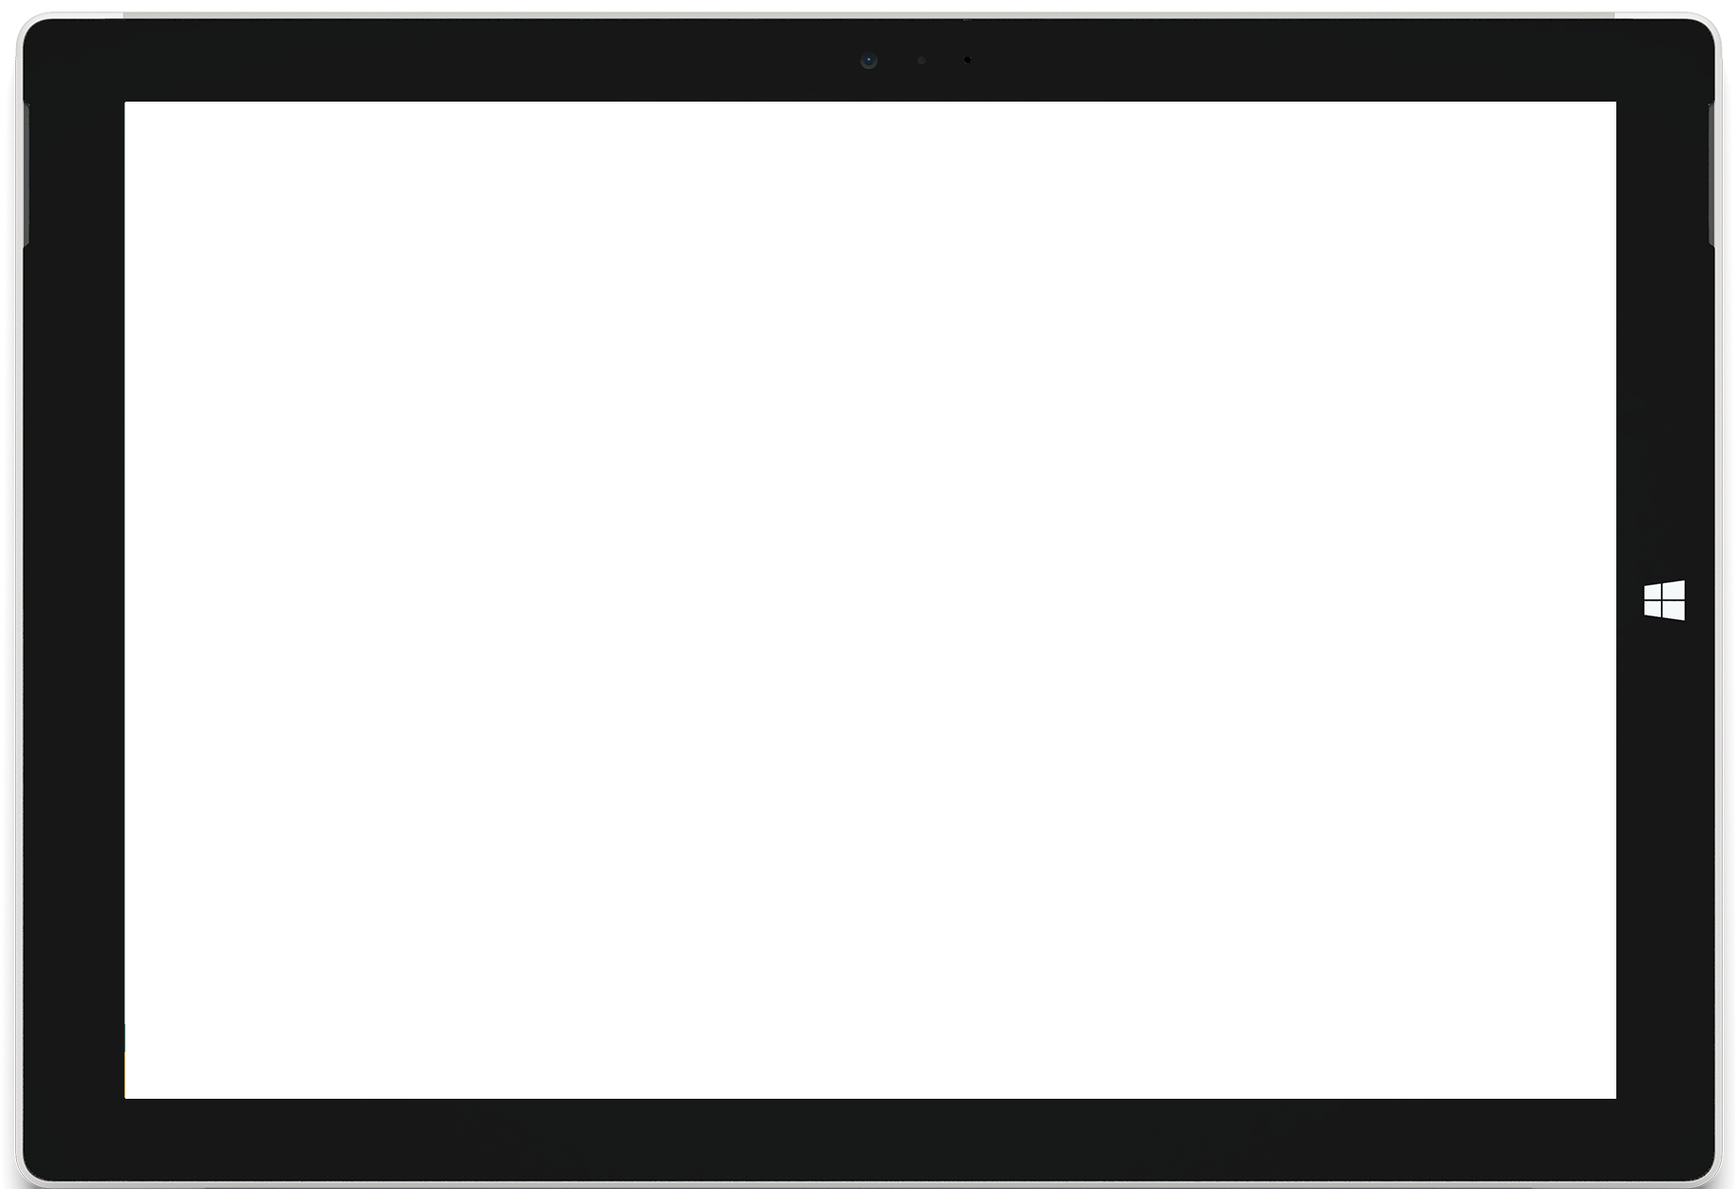
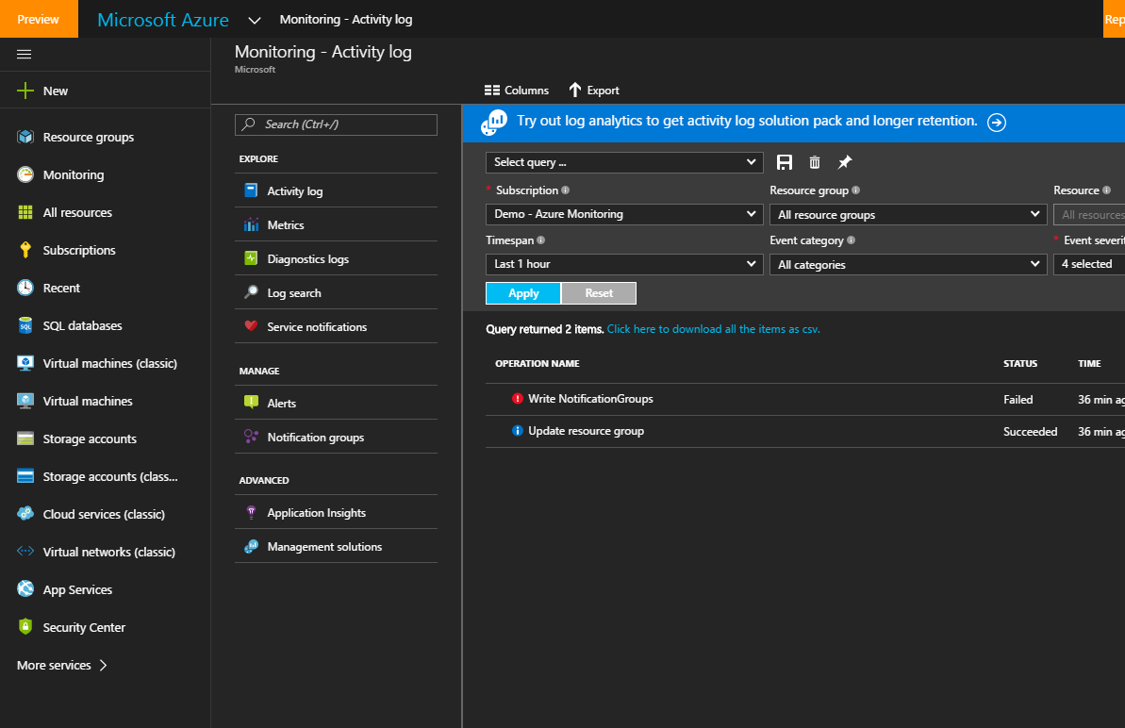
Azure Monitor: Highlights
Easy discovery and centralized access to all Monitoring, Diagnostics, Alerts, Notifications
Platform Resource Metrics, 1m granularity, 30 day retention, no setup, always on
One Dashboard to monitor everything, Platform, Apps, OMS Solutions, Security, etc.
Azure Monitor
Integration of Application Insights for custom and app metrics
Operation Management Suite (OMS) Log Analytics across subscriptions
Directly integrates with rich ecosystem of partner monitoring tools
Notes:
Key Points:
Single entry point
Metrics at 1 minute granularity, automatic 30 day retention, always on and no setup required.
Dashboards to track whatever metrics you want from the platform, application, your own custom, integrated with Application Insights, and OMS
Deep integration with OMS brings the power of log analytics to the Azure Portal, enabling you to reason and derive insights on all your resources, regardless of their subscription.
Rich ecosystem of partners

Slide 20
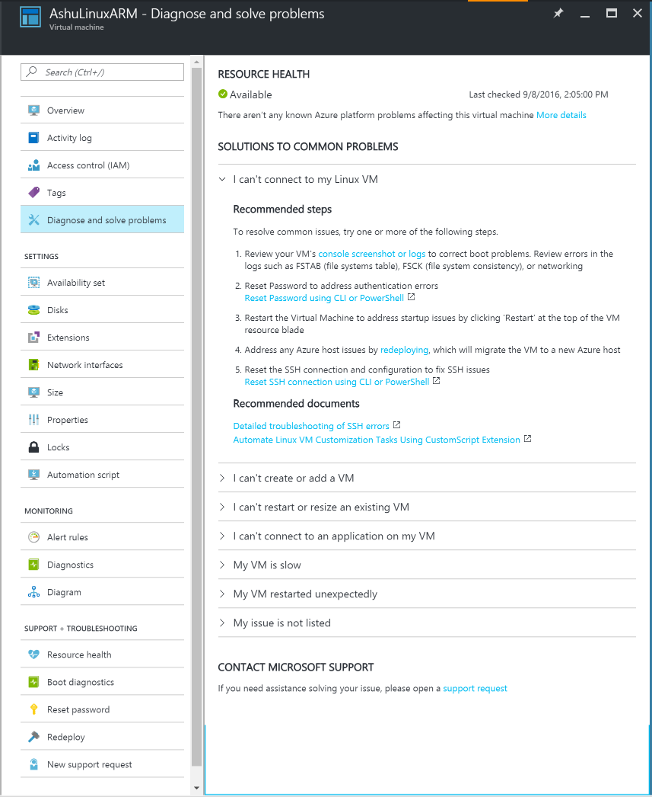
Diagnostics
The Diagnose and solve problems blade gives customers the tools they need to solve problems. It provides their resource health, solutions to common problems, and a link to open a support request.
Provide single location for tools and solutions
Provide actionable steps to solve the most common customer problems
Notes:
Key Points:
I’ve defined alerts and notifications, if something is wrong, how do I fix it?
Azure Portal has a single location for diagnosing and solving problems.
It provides actionable steps for the most common problems, and we are constantly curating this list
Running on a platform/infrastructure you don’t control, when you experience a problem your first question is, is this my problem, or is there something unexpected going on beneath me?

Slide 21
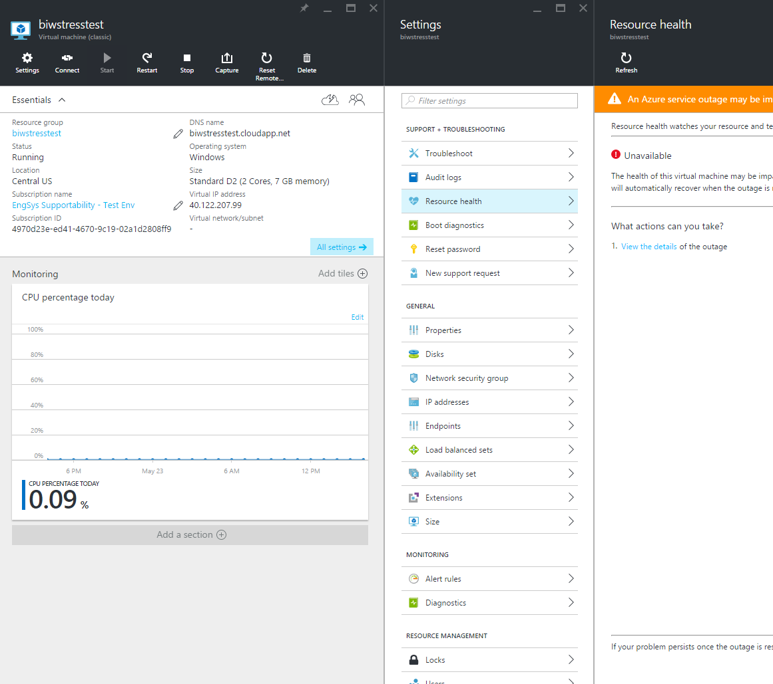
Monitor your resource health
Granular platform events
Check the health of all resources (in a subscription)
On-demand checks for VMs
Accessible through an API
Notes:
Key Points:
Azure Resource Health tells you if your resource is healthy from Azure’s perspective.
The resource health heartbeat tells you if your resource is healthy or not.
If your resource fails a health check then you can open a support request regardless of the support plan you have, even if you don’t have one, it’s free.

Slide 22
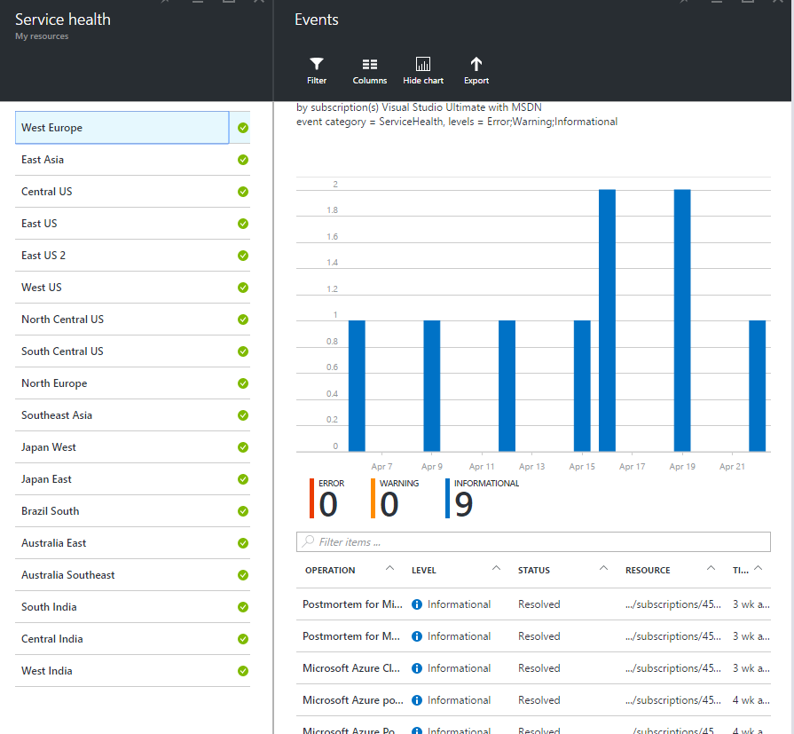
Communications in Azure portal
Targeted communications
Filter by Region/Events/Date Range
Access Post incident reports (PIRs)
Notes:
If there is something happening with the cloud, the Service Health Dashboard will show you by region.

Slide 23






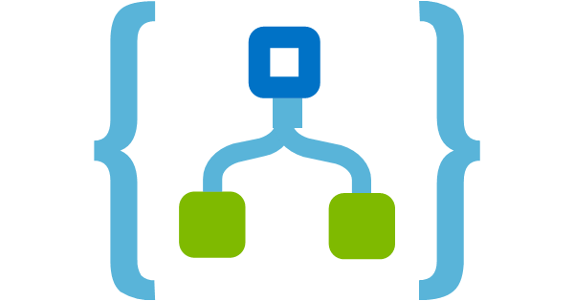
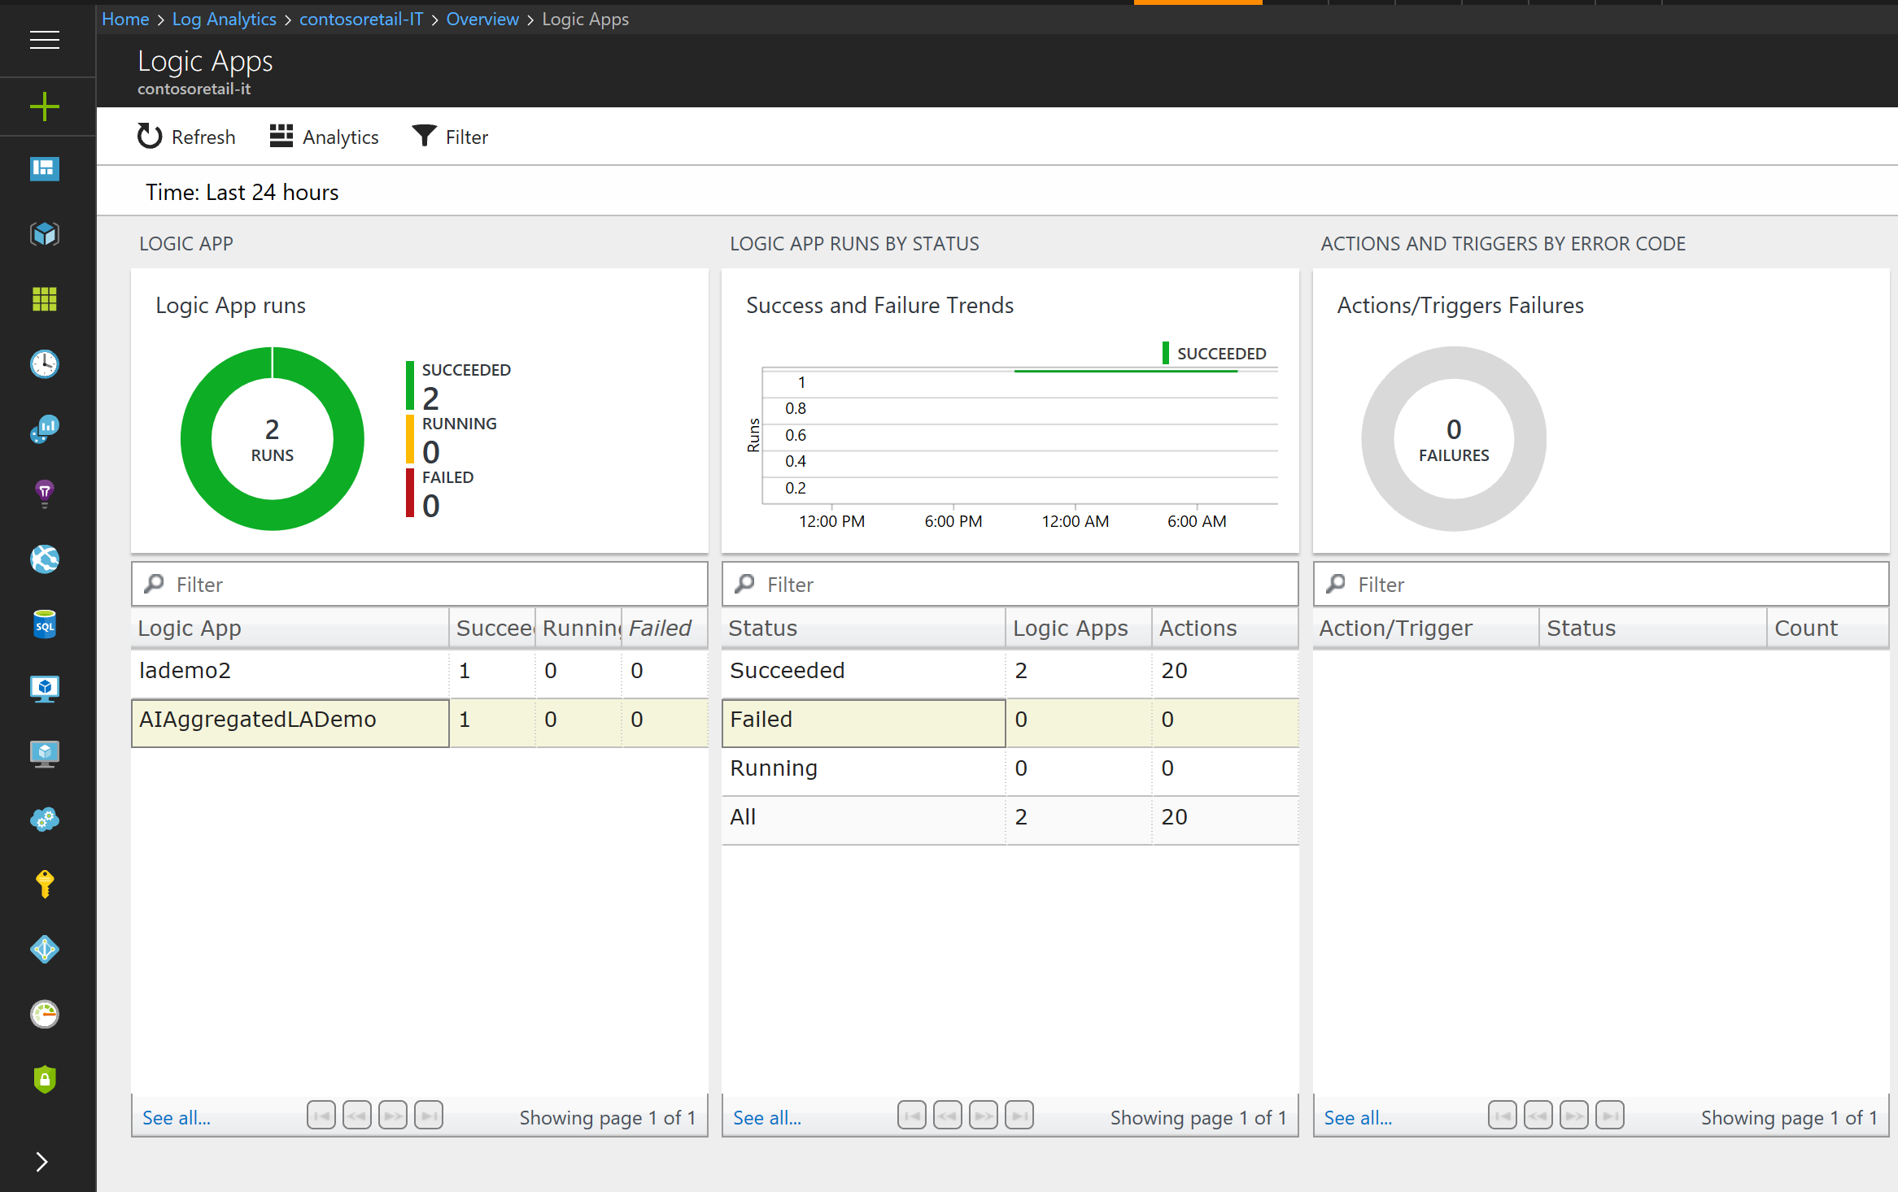
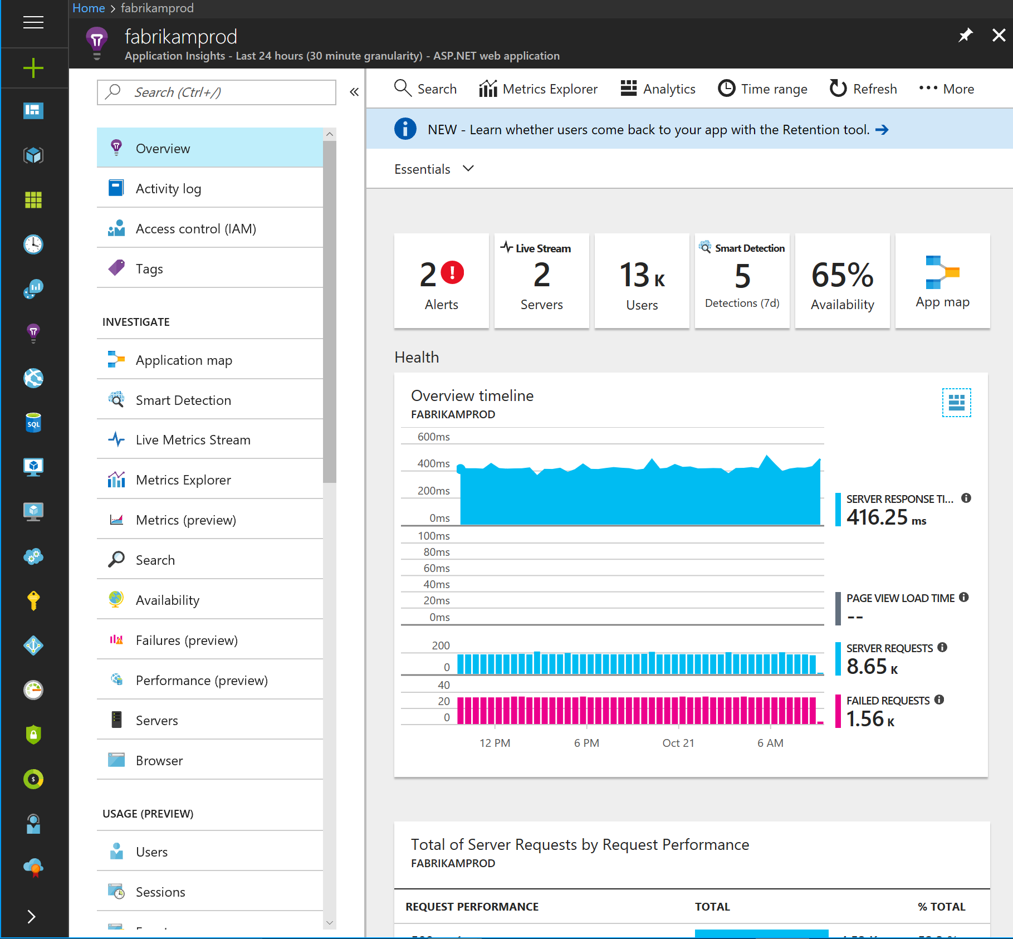
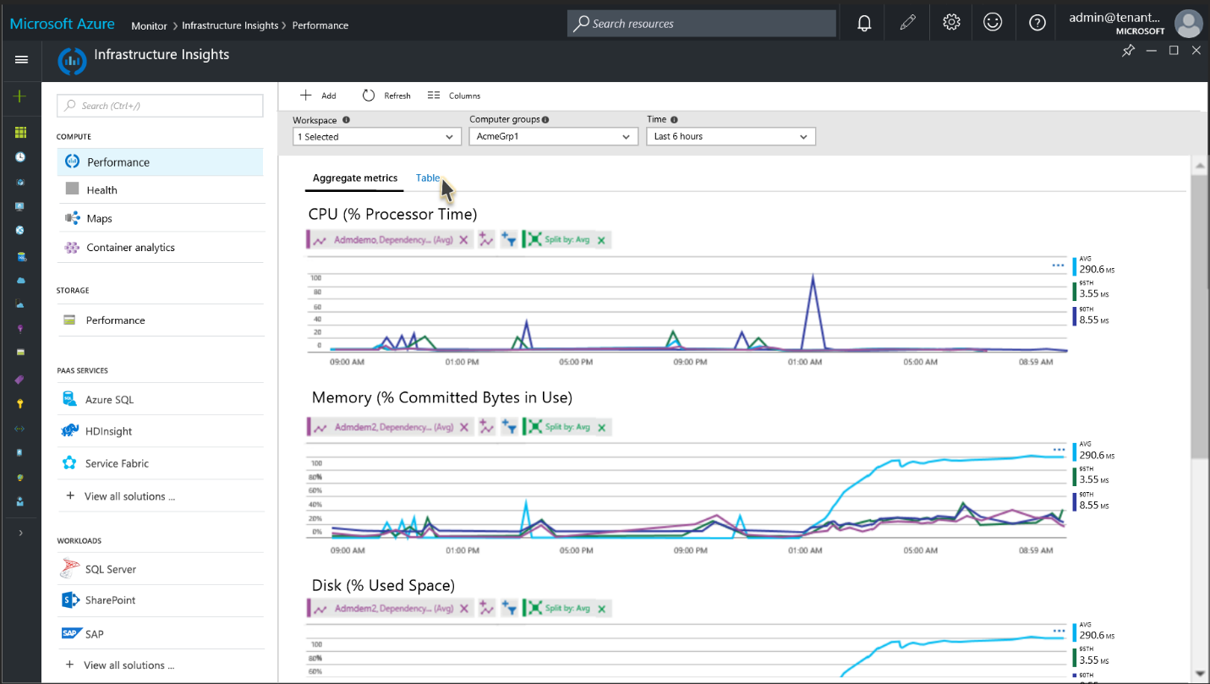
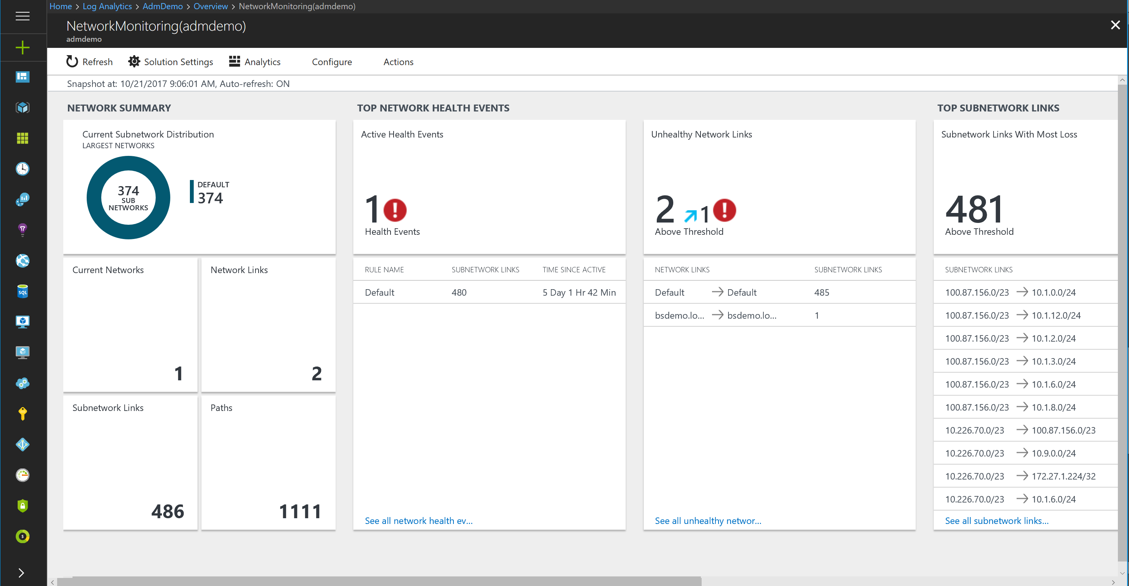
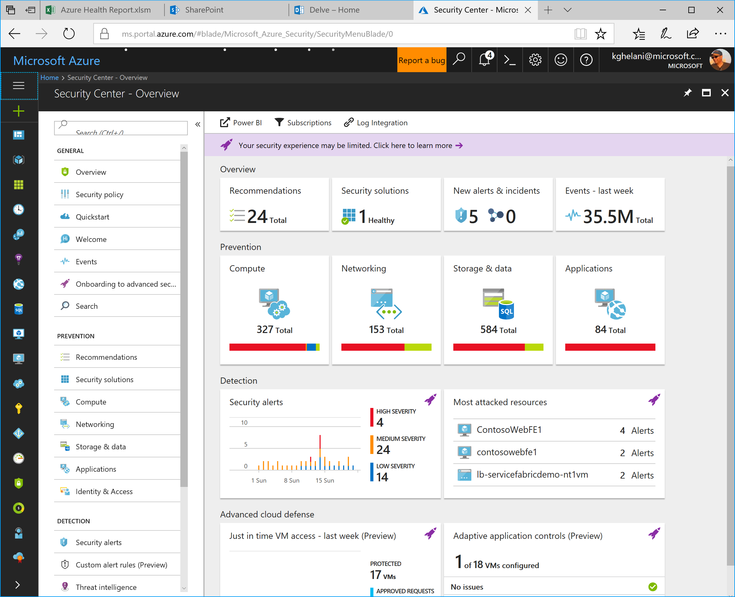


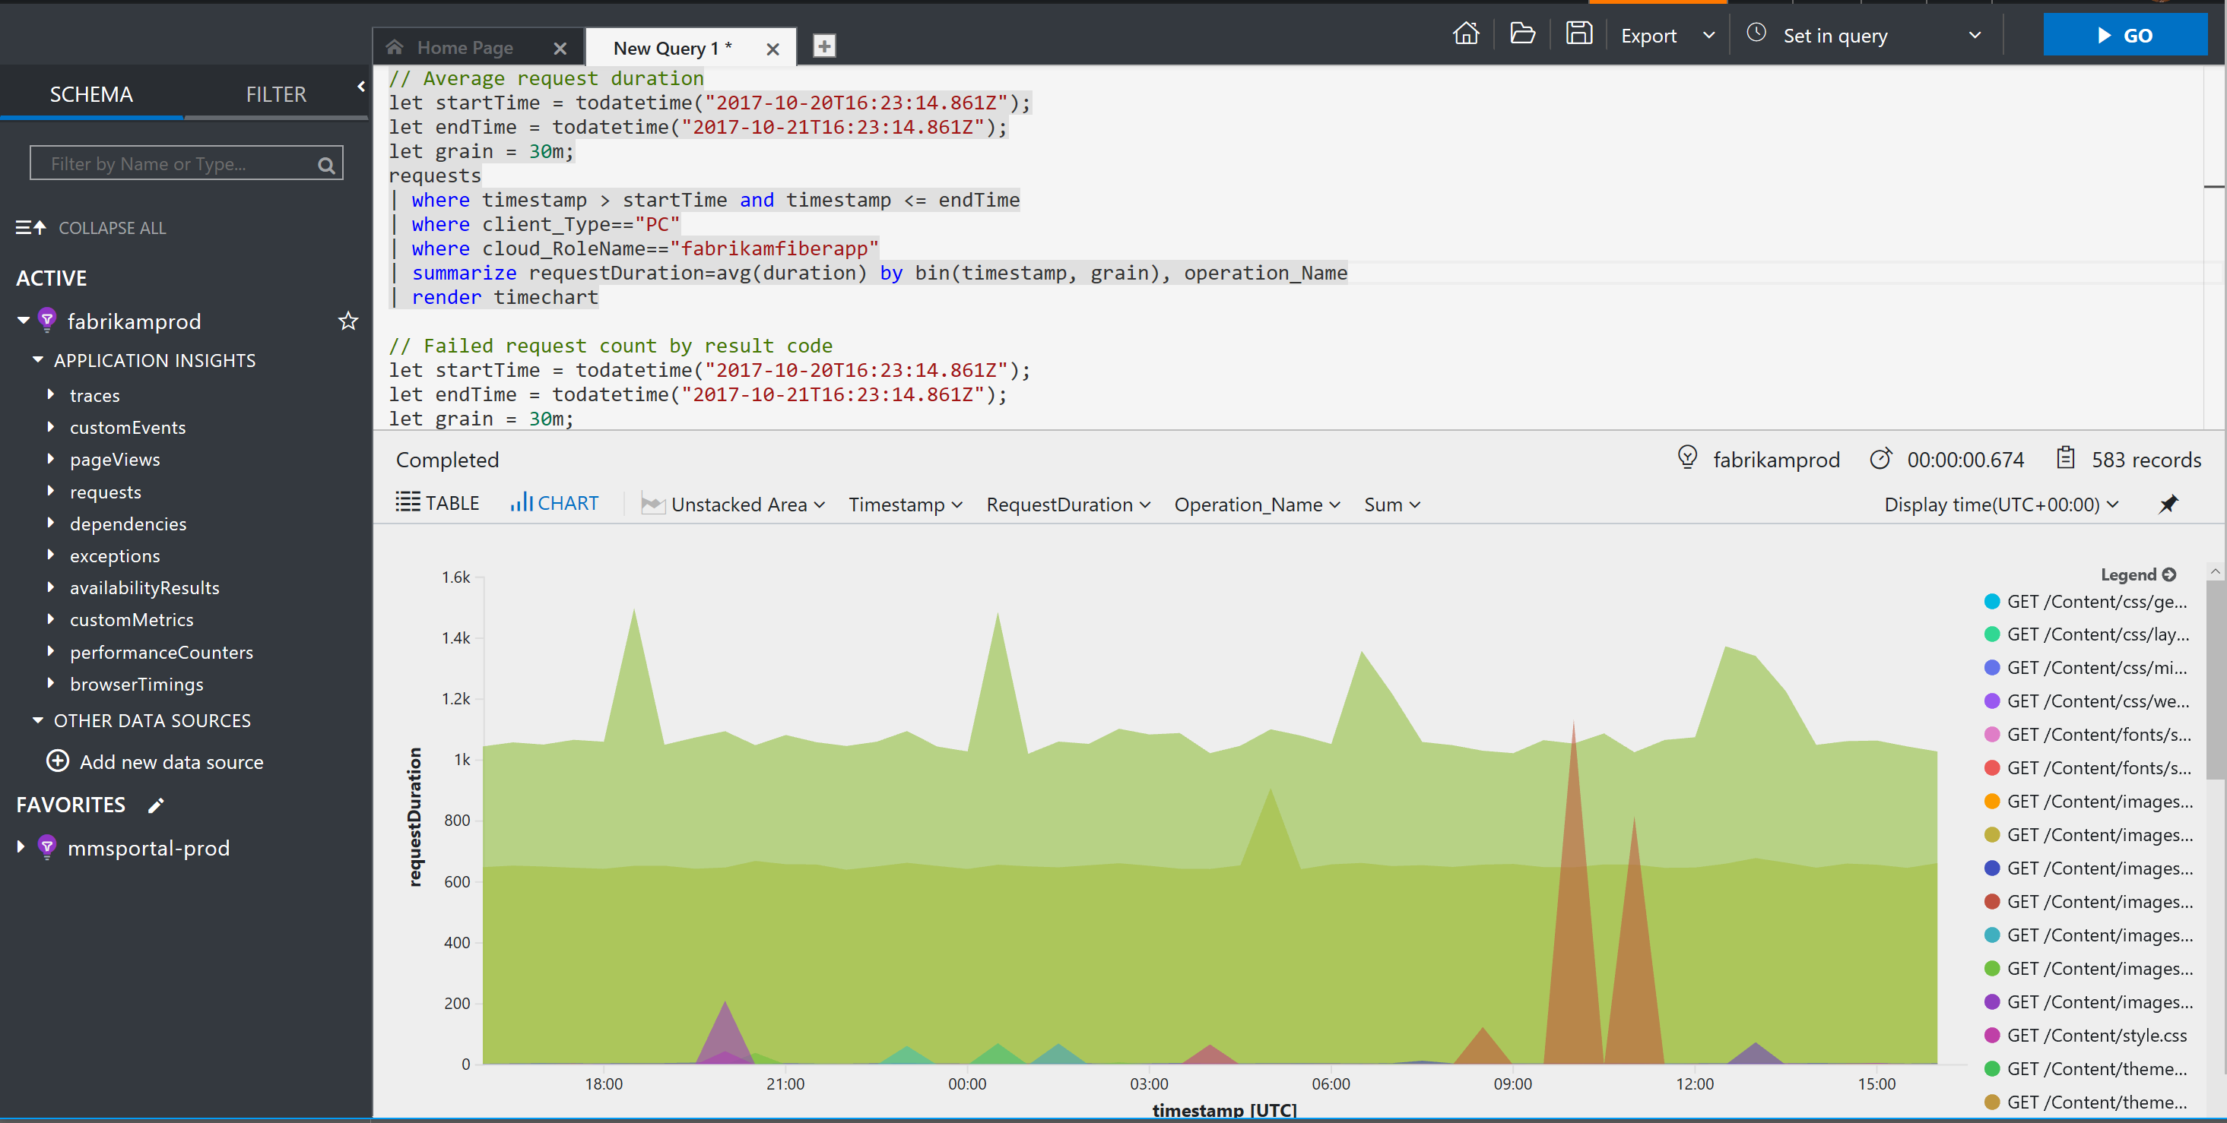



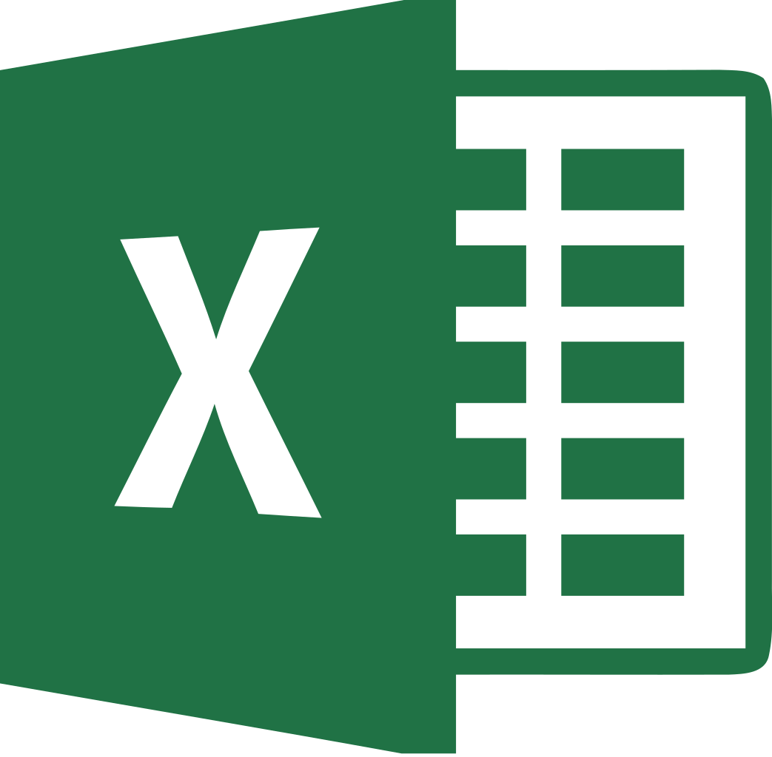


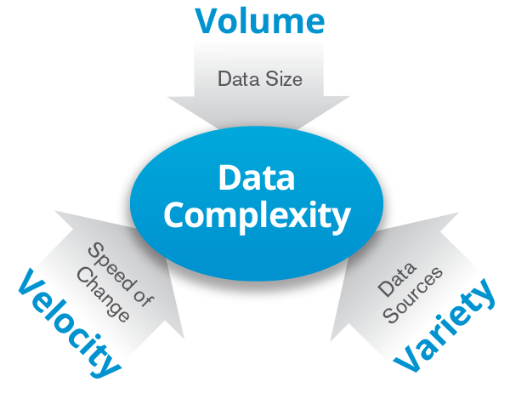
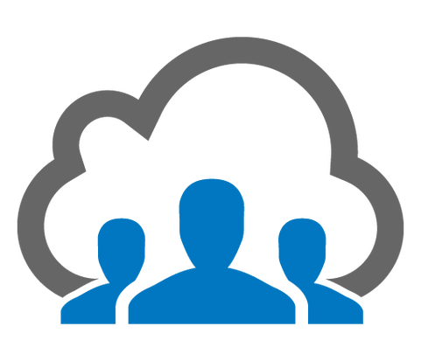
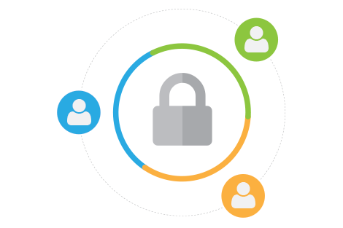
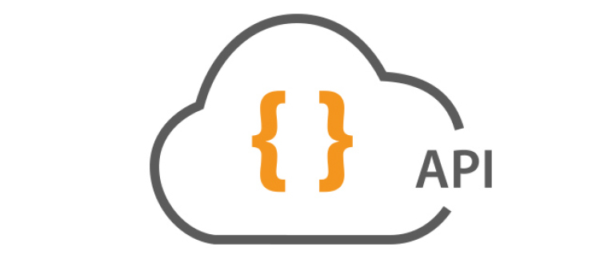
Azure Log Analytics
Powered by Kusto
Targeted Insights
Solutions
IoT
Dev
Ops
SecOps
NwOps
Multiple
Azure Time Series Insights
Context based experiences
Data
Explorers
Core
experiences
Multi Tenant
SaaS Platform
Azure Log Analytics
Scalable Big Data Platform
Kusto

Slide 24


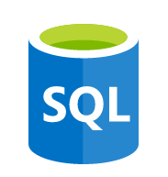





App
frontend
Real-time correlation
and analytics
Middleware
Application
Insights
Backend
Built-in operational
visibility
Operating
system
Data ingestion and correlation
Linux Server
Microsoft Azure
Log
analytics
Virtual
machine
Flexible turn-key integrations
Networking
Monitor
Virtual network
Load balancer
DNS
Actionable app-aware insights

Slide 25
Full stack of cloud management capabilities
GOVERN
SECURE
Policy Management
Cost Management
Security Management
Threat Protection
CONFIGURE
Microsoft Azure
PROTECT
Configuration
Update Management
Automation
Scripting
Backup
Disaster Recovery
MONITOR
App, Infra, & Network Monitoring
Log Analytics and Diagnostics
Notes:
Talk through the investments of what MSFT/Azure sees as important for enterprise cloud management platform
The combination together is powerful. Truly integrated capabilities SaaS management and security.
To be successful in the Cloud era, enterprises must have visibility/metrics and controls on every component to pinpoint issues efficiently, optimize and scale effectively, while having the assurance the security, compliance and polices are in place to ensure the velocity.
Native Security and Management in Azure
Enterprise grade capabilities natively from the cloud provider Azure
Integrated and interconnected across data and experiences
Management capabilities included with the flexibility to increase or choose 3rd party
Can make the point that for those familiar with OMS these were the foundation for what we now have natively within Azure.
5 main areas:
Secure: While Azure is trusted and secure platform, you as a customer have your own security settings you need to manage. You also need to be able to protect your individual machines against threats and monitor the security posture of your system.
Protect: Your VMs and applications in the cloud need to be backed up and protected in the event of data loss. With disaster recovery from on-prem to the cloud, or from one cloud to another, you can avoid downtime and keep your applications up and running.
Monitor: Every operations manager and every developer needs to be able to see the health and performance of their applications, infrastructure, and network. And seeing insights across all three together in a single dashboard can save time and resources in troubleshooting and preventing issues in the future.
Configure: For managing Azure and hybrid workloads at scale, automation and configuration capabilities help you create runbooks to automate tasks, manage the configuration settings and track changes, and monitor and deploy missing updates. Additionally in Azure you can use PowerShell and Cloud Shell for command line scripting.
Govern: Many customers need a way to look across cloud resources to assess and enforce enterprise-wide standards and policy compliance for security and management. In addition, they need to manage and monitor costs for the cloud. We recently acquired Cloudyn, a multi-cloud cost management solution to help our customers with this challenge.

Slide 26
Simple and unified experience
COLLECT AND
INDEX DATA
SEARCH AND
INVESTIGATE
MONITOR
AND ALERT
UNIFIED
EXPERIENCE
Expand your enterprise management with a consistent experience
CORRELATE AND ANALYZE
VISUALIZE
AND REPORT
Single platform for overall management
Leverage existing management platform
Access anywhere with a consistent user experience
Single pane of control
Unified experience
Integrate with existing systems
Connect with isolated resources
Control from anywhere
Consistent user interface
Notes:
Connect with all OMS capabilities within a single dashboard
Single pane of control for configuration, automation, monitor, protect, security
Leverage existing management platform (No rip and replace)
System Center, Zabbix, Nagios integration
OMS Gateway
Forward custom logs
Access anywhere with the same look and feel through your mobile
Mobile application for iPhone, Android and Windows Phone
Consistent user experience across OMS and Azure services

Slide 27



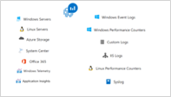

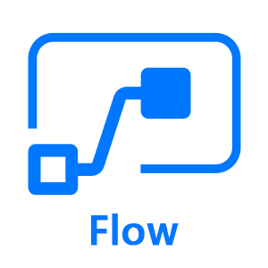

Azure Log Analytics Ecosystem
Ingestion
Exploration
Export & Correlation
Microsoft Monitoring Agent
Microsoft Azure Portal
Advanced Analytics Portal
Azure Monitor
Service Map
Application Insights Connector
Power BI
Azure Extensions
Data Collector APIs
Linux
Blob storage
Microsoft Flow
SCOM MP
Data Access REST APIs
Solutions
Security & Audit
Antimalware
Azure Activity Logs
Update Management
Azure Automation
Change Tracking
Wire Data
Network Performance Monitoring
Office 365
Azure SQL Analytics
Azure Containers
Upgrade Compliance
Upgrade Readiness
Device Health
Service Map
Alert Management
Capacity Management
HD Insights
SQL Assessment
AD Assessment
SQL Assessment Plus
Exchange Assessment
SP Assessment
VMWare
Azure App Gateway
Azure NSG Analytics
Key Vault Analytics
MORE….
…

Slide 28






UNIFIED EXPERIENCE
COLLECT AND INDEX DATA
SEARCH AND INVESTIGATE
CORRELATE AND ANALYZE
VISUALIZE AND REPORT
MONITOR AND ALERT
Windows agents
Log Analytics
Automation
Site Recovery
Backup
SCOM
Linux / FluentD
Operations Management Suite
REST Collection API
Sample list of log/metrics that OMS collects:
Custom Application/Infra logs
Windows event logs
Window performance counters
Security Event Logs
IIS Logs
ETW logs
Azure Diagnostics
SaaS services
O365
Azure Storage /
Azure Diagnostics
Event Hub
Log Stash

Slide 29
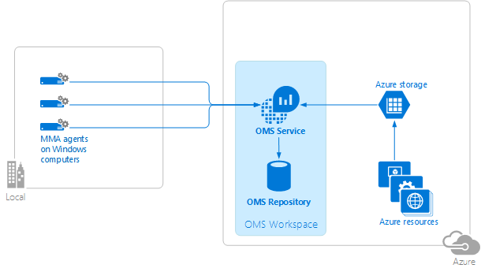
UNIFIED EXPERIENCE
COLLECT AND INDEX DATA
SEARCH AND INVESTIGATE
CORRELATE AND ANALYZE
VISUALIZE AND REPORT
MONITOR AND ALERT
Windows agents
Operations Management Suite
Connect to Windows computers in your on-premises infrastructure directly to OMS workspaces by using a customized version of the Microsoft Monitoring Agent (MMA).
https://azure.microsoft.com/en-us/documentation/articles/log-analytics-windows-agents/

Slide 30
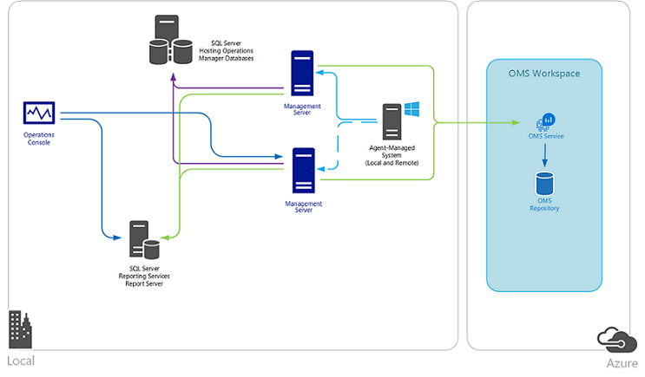
UNIFIED EXPERIENCE
COLLECT AND INDEX DATA
SEARCH AND INVESTIGATE
CORRELATE AND ANALYZE
VISUALIZE AND REPORT
MONITOR AND ALERT
SCOM
Operations Management Suite
Integrate Operations Manager with your OMS workspace to:
Continue monitoring the health of your IT services with Operations Manager
Maintain integration with your ITSM solutions supporting incident and problem management
Manage the lifecycle of agents deployed to on-premises and public cloud IaaS virtual machines that you monitor with Operations Manager

Slide 31
UNIFIED EXPERIENCE
COLLECT AND INDEX DATA
SEARCH AND INVESTIGATE
CORRELATE AND ANALYZE
VISUALIZE AND REPORT
MONITOR AND ALERT
Linux / FluentD
Operations Management Suite
Collect and act on data generated from Linux computers. Adding data collected from Linux to OMS allows you to manage Linux systems and container solutions like Docker regardless of where your computers are located—virtually anywhere.
Upload data (HTTPS)
omsagent (FluentD)
syslog
OMS Service
Firewall/proxy
OMI Server
(CIM Server)
Nagios
Operating System
Providers
Apache
Zabbix
MySQL
Containers
Docker
omsconfig (DSC)
Pull configuration
(https)
PS DSC
Linux Computer

Slide 32




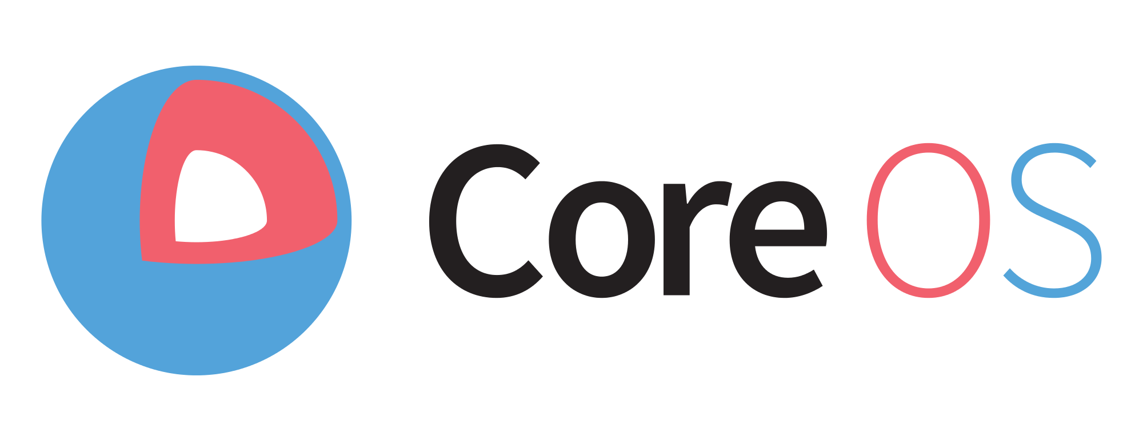


UNIFIED EXPERIENCE
COLLECT AND INDEX DATA
SEARCH AND INVESTIGATE
CORRELATE AND ANALYZE
VISUALIZE AND REPORT
MONITOR AND ALERT
Linux / FluentD
Operations Management Suite
Supported Linux platform
6.x 32/64-bit 7.x 32/64-bit 8.x 32/64-bit
5.x 32/64-bit 6.x 32/64-bit 7.x 64-bit
5.x 32/64-bit 6.x 32/64-bit 7.x 64-bit
2013.09 – 2015.09
12.x 32/64-bit 14.x 32/64-bit
15.x 32/64-bit 16.x 32/64-bit
alpha
beta
stable
10.x 32/64-bit 11.x 32/64-bit
12.x 64-bit
5.x 32/64-bit 6.x 32/64-bit 7.x 64-bit

Slide 33
UNIFIED EXPERIENCE
COLLECT AND INDEX DATA
SEARCH AND INVESTIGATE
CORRELATE AND ANALYZE
VISUALIZE AND REPORT
MONITOR AND ALERT
REST Collection API
Operations Management Suite
Leverage REST collection API to ingest custom data to Operations Management Suite
Post json document to HTTPS endpoint
Ensure json is flattened and not nested
$json = @"
[{ "slot_ID“ : 12345,
"ID“ : "5cdad72f-c848-4df0-8aaa-ffe033e75d57",
"availability_Value": 100,
"measurement_Name“ : "last_one_hour",
"duration“ : 3600,
"ExecutionTime“ : "2016-05-12T20:00:00.625Z"
},
{ … }]
"@
Authenticated using workspace key to hash content
API
Log Search API Create, manage and run searches Alert API Create and manage alerts
Powershell
Log Analytics cmdlets Nouns ComputerGroup IntelligencePacks (solutions) LinkTargets SavedSearch SavedSearchResults StorageInsights Workspace WorkspaceManagementGroups WorkspaceSharedKeys WorkspaceUsage
Notes:
OMS Linux agent (Syslog using fluentd and collectd)
https://blogs.technet.microsoft.com/msoms/2016/05/12/syslog-collection-in-operations-management-suite/
Use collectd to bring metrics into OMS Log Analytics
https://blogs.technet.microsoft.com/msoms/2016/07/14/bring-your-custom-collectd-metrics-into-the-oms-log-analytics-platform/
Linux and Docker management
https://blogs.technet.microsoft.com/momteam/2015/11/03/announcing-linux-docker-container-management-with-oms/
Monitor VMWare using OMS Log Analytics (custom logs)
https://blogs.technet.microsoft.com/msoms/2016/06/15/monitor-vmware-using-oms-log-analytics/
HTTP Ingestion API
Documentation
https://onedrive.live.com/redir?resid=E6DDF48D2F1DA0EB!7047&authkey=!AEjZIm-nLuLvzgU&ithint=folder%2cdocx
Use your favorite language
Client-side bindings for c#, .NET, node js, Powershell, python
Custom data into OMS Log Analytics
https://blogs.technet.microsoft.com/msoms/2016/07/21/bring-your-custom-json-data-to-log-analytics-oms-with-twitter-data-example/

Slide 34
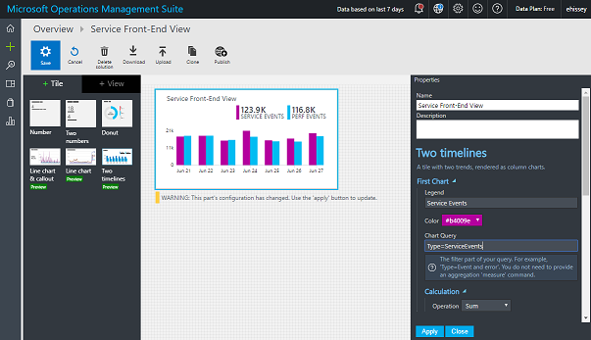
UNIFIED EXPERIENCE
COLLECT AND INDEX DATA
SEARCH AND INVESTIGATE
CORRELATE AND ANALYZE
VISUALIZE AND REPORT
MONITOR AND ALERT
View designer
Create visual tiles based on searches
Assemble tiles on a dashboard
View Designer editing Overview Tile to show custom service’s front-end custom events and performance data
Notes:
Visualize your data your way
https://blogs.technet.microsoft.com/msoms/2016/06/30/oms-view-designer-visualize-your-data-your-way/
Use OMS View Designer for SQL Server monitoring
https://blogs.technet.microsoft.com/msoms/2016/07/22/use-oms-view-designer-for-sql-server-monitoring/
Customize your metrics chart visualization in OMS
https://blogs.technet.microsoft.com/msoms/2016/07/25/customize-your-metrics-chart-visualization-in-oms/

Slide 35
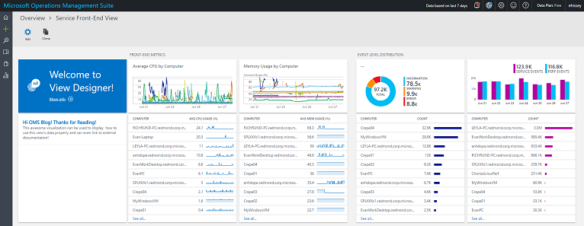
UNIFIED EXPERIENCE
COLLECT AND INDEX DATA
SEARCH AND INVESTIGATE
CORRELATE AND ANALYZE
VISUALIZE AND REPORT
MONITOR AND ALERT
View designer
Create visual tiles based on searches
Assemble tiles on a dashboard
Complete with metrics visualized in line charts, distributions of event levels for my service, and the amount of data getting for both types of events. Each visualization can drill down into OMS Log search.
Notes:
Visualize your data your way
https://blogs.technet.microsoft.com/msoms/2016/06/30/oms-view-designer-visualize-your-data-your-way/
Use OMS View Designer for SQL Server monitoring
https://blogs.technet.microsoft.com/msoms/2016/07/22/use-oms-view-designer-for-sql-server-monitoring/
Customize your metrics chart visualization in OMS
https://blogs.technet.microsoft.com/msoms/2016/07/25/customize-your-metrics-chart-visualization-in-oms/

Slide 36
Fast troubleshoot and auto remediate
COLLECT AND
INDEX DATA
SEARCH AND
INVESTIGATE
MONITOR
AND ALERT
MONITOR
AND ALERT
Solve issues as quickly as possible in an automated fashion to improve your SLA
UNIFIED
EXPERIENCE
CORRELATE AND ANALYZE
CORRELATE AND ANALYZE
VISUALIZE
AND REPORT
Identify root cause with powerful search
Community based automation
Auto remediate
Powerful search
Alert notification
Leverage PowerShell community for automating via PowerShell based runbooks
Leverage automation from the cloud
Connect existing alerts to auto remediate

Slide 37
Application monitoring and analytics
Visibility
Insights
Optimization
Get the big picture
Find & fix problems
Build, measure, learn

Slide 38

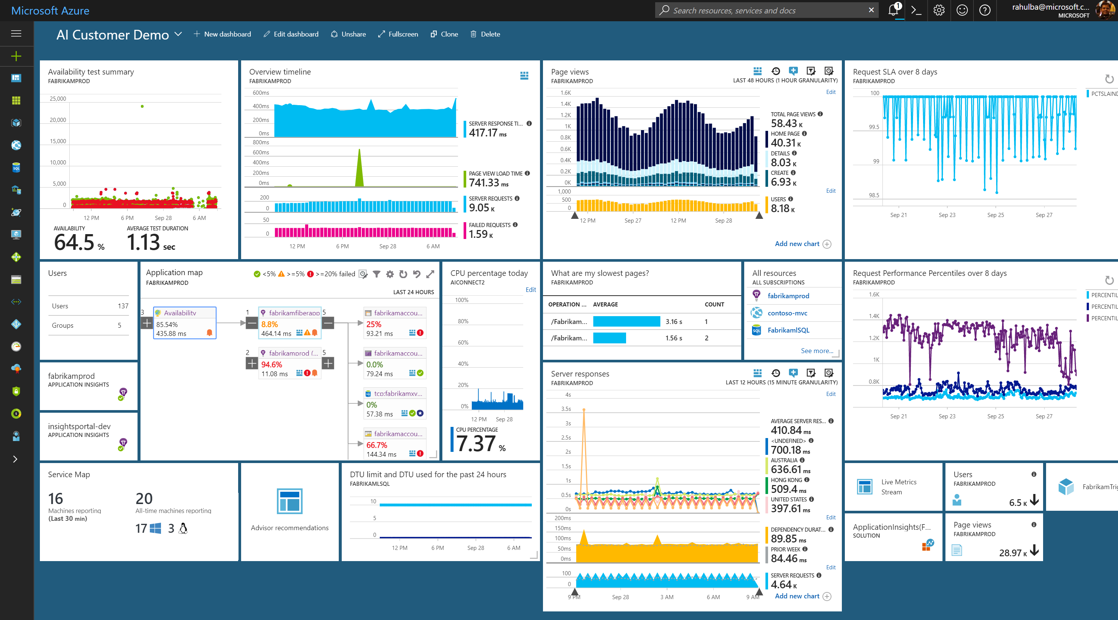
Azure Application Insights
Visibility – Get the big picture
Monitoring across App & Infra
Alerts & Notifications
Visualization & Collaboration
Insights – Find & fix problems
Detect, Diagnose & Debug Failures
Advanced Analytics with ML
Setup automated actions
Optimization – Build, measure, learn
Performance Optimization & Profiling
User Behaviour & Customer Insights
Impact Correlation

Slide 39


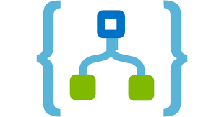



Application Insights ecosystem
Ingestion
Exploration
Export & Correlation
Application Insights
Microsoft Azure Portal
OMS Connector
Power BI
Open Source SDKs
Status Monitor
Azure Extensions
Azure Monitor
Application Map
Live Metrics Stream
Profiler & Debugger
Microsoft Flow
Logic Apps
Blob storage
Stream Analytics
SCOM MP
VS App Center
Open Schema
Visual Studio Team Services
Visual Studio IDE
Analytics Portal
Data Access REST APIs
Support (Cloud/On-Premises/Hybrid)
Officially Supported
C#/VB.NET
Java
JavaScript
Node.JS
Public Endpoints
Community Supported
PHP
Python
Ruby
Platforms & Frameworks
ASP.NET & Core
J2EE
Android & iOS
Azure App & Cloud Services
Azure Functions
Azure Service Fabric
Docker & Kubernetes
CMS
Drupal
Joomla
SharePoint
WordPress
Orchard
Logging Frameworks
Log4Net & NLog
Log4J & Logback
System.Diagnostics
Semantic Logging (SLAB)

Slide 40
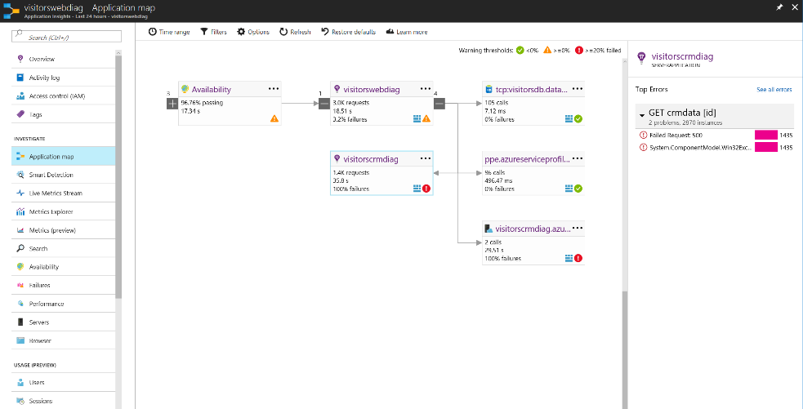
App Map to Pinpoint Problem Server

Slide 41
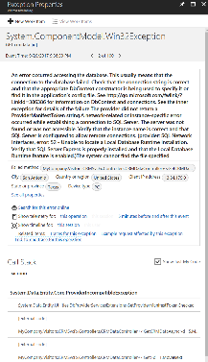
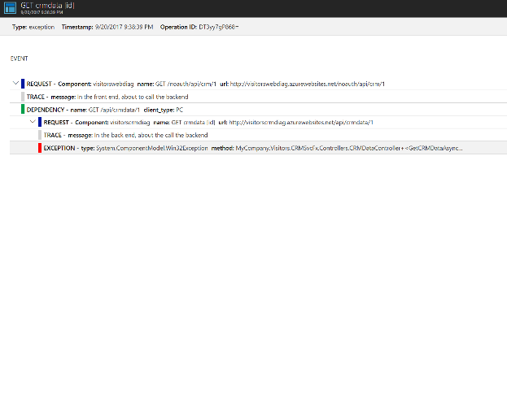
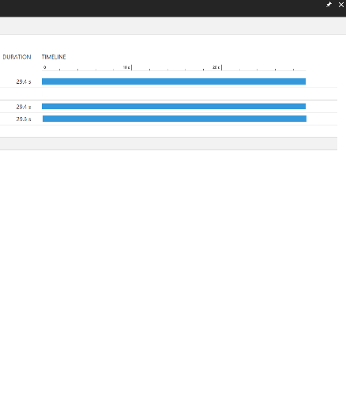
Correlated tracing across servers

Slide 42
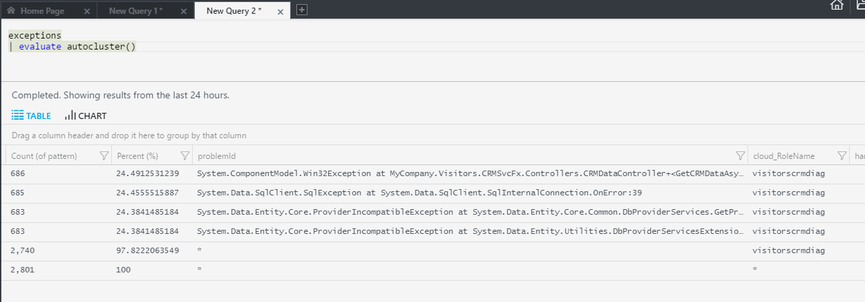
Using Analytics to Dig Deeper

Slide 43
Optimizing Performance
Deliver a great user experience: <500ms
Minimize cost of cloud resources
Overall minimize what code is doing over time:
Request:
Code waiting
0ms
Network
Process Inputs
Make DB or HTTP Call
Process Results
Return Results
1000 ms
Code executing on CPU
Second Request:
Done using CPU
Done using CPU
Resource Contention
0ms
Network
Process Inputs
Make DB or HTTP Call
Process Results
Return Results
1200 ms

Slide 44
Scenarios
Performance issues that affect every request
Entity Framework
CSHTML rendering
Blob store/http calls/etc.
Performance issues that happen at scale or infrequently
Resources overutilized
Garbage collection
Lock/resource contention

Slide 45
Application Insights Profiler
Helps you see what code is doing over time
Captures data from production
Samples 2 minutes/hour
Capture all requests that happen during that time
Data is stored for 5 days
Segments results into typical vs. long tail (median, 95th)

Slide 46
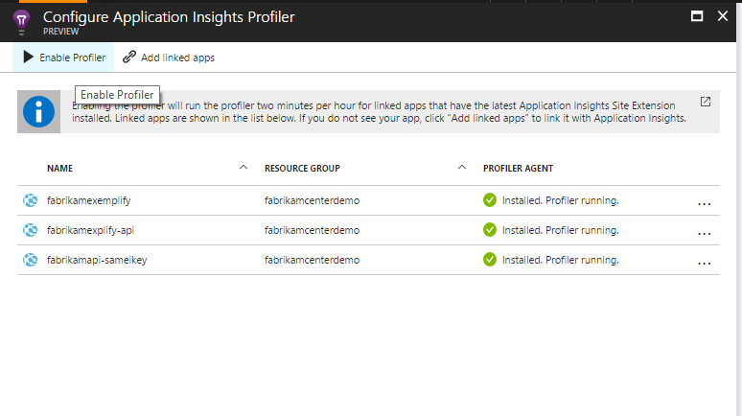
Enable Profiler from Performance Blade
Requirements:
.NET Framework 4.6
.NET Core on Windows
GA for Azure App Service
Preview Available for Compute (VMs, Service Fabric, Cloud Services)

Slide 47
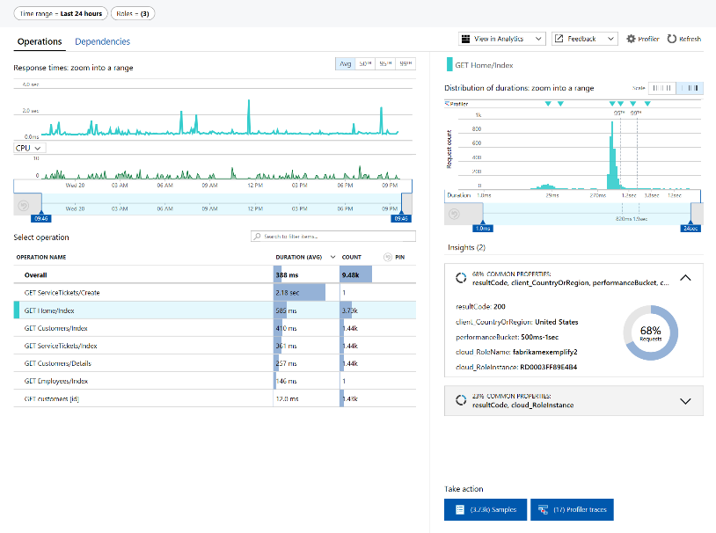
Prioritize Operations by Looking at Percentiles

Slide 48
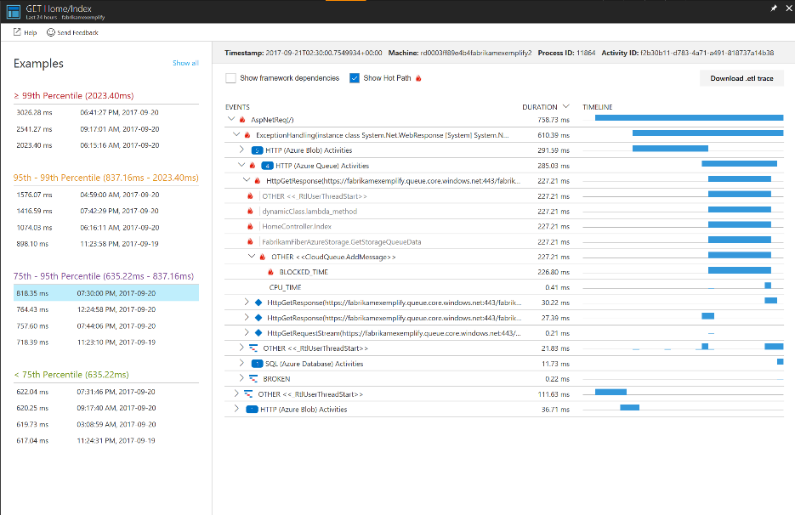
Drill Into Example Requests

Slide 49
Application Insights: Recap
Get the big picture
Find & fix problems
Build, measure, learn
Azure Metrics & Dashboards
Alerts & Notifications
Synthetic Monitoring
Live Metrics Stream
Application Map v2 NEW!
Workbooks NEW!
Flow/Logic Apps Integration
VSTS/RM Integration NEW!
Data Access APIs & Export
Smart Detection
E2E Transaction Tracing NEW!
Failure Diagnostics & Snapshot Debugging
VS CodeLens Integration
Advanced Analytics with Machine Learning
Azure Monitor Auto-scaling
Performance Monitoring & Profiling
Custom Instrumentation
User/Session/Event Monitoring
Cohorts & Funnels
Customer Retention
User Flows
Impact Correlation NEW!

Slide 50
Roadmap
Support & On-boarding
App Insights region expansion to India, Canada & UK
Improve support for Java, Node.JS & Linux based apps
Visibility - Get the big picture
Single consistent experience for creating & managing all Alerts in Azure
Alert for all metrics & logs (converted to metrics) in <5 mins
Dynamic thresholds to minimize false positives & reduce noise
Notification actions via Logic apps, Functions, Pager Duty, Slack, Jira & Teams
E2E cross-component health in Application Map
Insights - Find & fix problems
Smart Detection framework for custom smart alerts
Debug transaction across the entire stack
Live investigations of failures
Merging with Log Analytics/Kusto platform for convergence with Infra Telemetry
Optimization – Build, measure, learn
Correlate changes in business KPIs with application performance & failures

Slide 51

© 2016 Microsoft Corporation. All rights reserved. Microsoft, Windows, Windows Vista, and other product names are or may be registered trademarks and/or trademarks in the U.S. and/or other countries.
The information herein is for informational purposes only and represents the current view of Microsoft Corporation as of the date of this presentation. Because Microsoft must respond to changing market conditions, it should not be interpreted to be a commitment on the part of Microsoft, and Microsoft cannot guarantee the accuracy of any information provided after the date of this presentation. MICROSOFT MAKES NO WARRANTIES, EXPRESS, IMPLIED OR STATUTORY, AS TO THE INFORMATION IN THIS PRESENTATION.

